Slide 1
WEB – APP TO KEEP CHECK ON THE HEALTH OF POPULATION IN A PARTICULAR AREA
PRESENTED BY:
TECH-KNIGHTS
(MEHAR PARMAR
PARICHETA VERMA)

Slide 2
POPULATION HEALTH MANAGEMENT FOR HEALTH-CARE
Population Health Management is an important tool that is increasingly being used by health care providers to manage and control the escalating costs.
The crux of Population Health Management is to use data to improve health outcomes.
Tracking, monitoring, and bench marking are the three bastions of Population Health Management, aimed at improving clinical and health outcomes while managing and reducing cost.

Slide 3
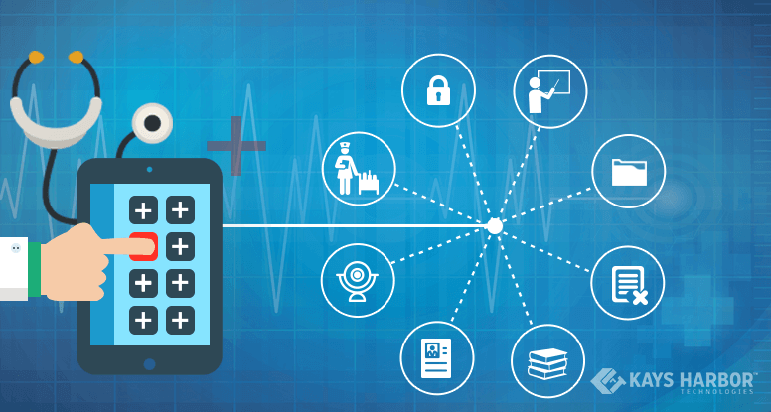
BENEFITS

Slide 4
BENEFITS
Managing useful information with the help of a healthcare app
Maintaining health record of patients
Accessing the health record sheet for knowing the status of patients
Better time management techniques
Collecting useful information on the healthcare industry
Providing better ways of communication for patients and doctors
Getting the best consultancy from the doctors on your problem
Taking effective medical education for improving your medical knowledge
Managing patients record on the app
Monitoring patients from your app

Slide 5
MARKET SCENARIO
The global mobile medical apps market comprises of software applications that can be executed on a mobile platform, or a web-based software connected to a mobile platform. The intended use of medical apps is wide ranging starting from the apps helping patients, or users to self-manage their disease or conditions without providing any diagnosis or treatment related recommendations, to the apps which claim to diagnose, cure, mitigate or prevent the onset of a disease or medical condition. Mobile medical apps are often used as an accessory to a regulated medical device, and they transform a mobile platform into a medical device.

Slide 6
With the rapid proliferation of mobile computing devices and smartphones in conjunction with growing consumer demand for mobile apps, there has been a plethora of medical apps in different online app distribution platforms such as, Google Play Store and Apple's app store. As of 2017, there was an estimated 1,59,000 medical apps in different app stores.

Slide 7
Mobile medical apps can significantly expose a patient or user to health risks if it ceases or fails to perform as intended. Hence, to provide guidance for the regulation of these apps, the U.S. Food and Drug Administration (FDA) for the first time issued a guidance document in the year 2015, which is particularly for the developers of mobile medical apps. The agency has already approved more than 100 medical apps in the last decade out of which around 40 medical apps were approved in the year 2015 and 2016. The FDA only intends to regulate mobile apps that pose greater risk to the patients in an event where an app fails to function as intended, and aims to exercise enforcement discretion for the mobile apps that pose minimal risks to the patients.

Slide 8
Despite these regulatory guidelines, there are hundreds of medically themed apps in Apple's App Store and Google Play Store that claim to assess, diagnose, and take control of the personal health of the patient. The usage of these apps could prove hazardous for a patient or user as these apps are not well backed by clinical evidences, and can even mislead a patient by showing false positive results. Agencies such as FDA is considerably taking steps to withdraw these apps from the app distribution platforms, and making provisions so that these kinds of apps are not marketed as replacement for legitimate medical equipment.

Slide 9
On the other hand, there are only a handful of medical apps that physicians or other healthcare professionals find useful in a clinical setting. These apps are cantered upon enabling doctors seeking drug related information or drug interaction (aka reference apps), and helping physicians during their clinical decision-making process. Some of the widely known and most downloaded medical apps in a clinical setting are Epocrates, PEPID, UptoDate, Medscape, and Doximity.

Slide 10
APPS THAT ALREADY EXIST
Clinical assistance apps
Reminder apps
Reference/database apps
Healthy life apps
Efficiency/communication apps
Specialty apps
Super apps
General facility information apps
Monitoring apps
Patient portal apps

Slide 11

THE BASIC IDEA
The basic idea was to estimate the number of patients suffering from different disease; admitted to different hospitals of a particular area.

Slide 12
REQUIREMENTS
The first and foremost requirement was a proper data to do the analysis and predict the results.
“https://www.healthdata.gov/dataset/patient-discharge-data-principal-diagnosis”

Slide 13
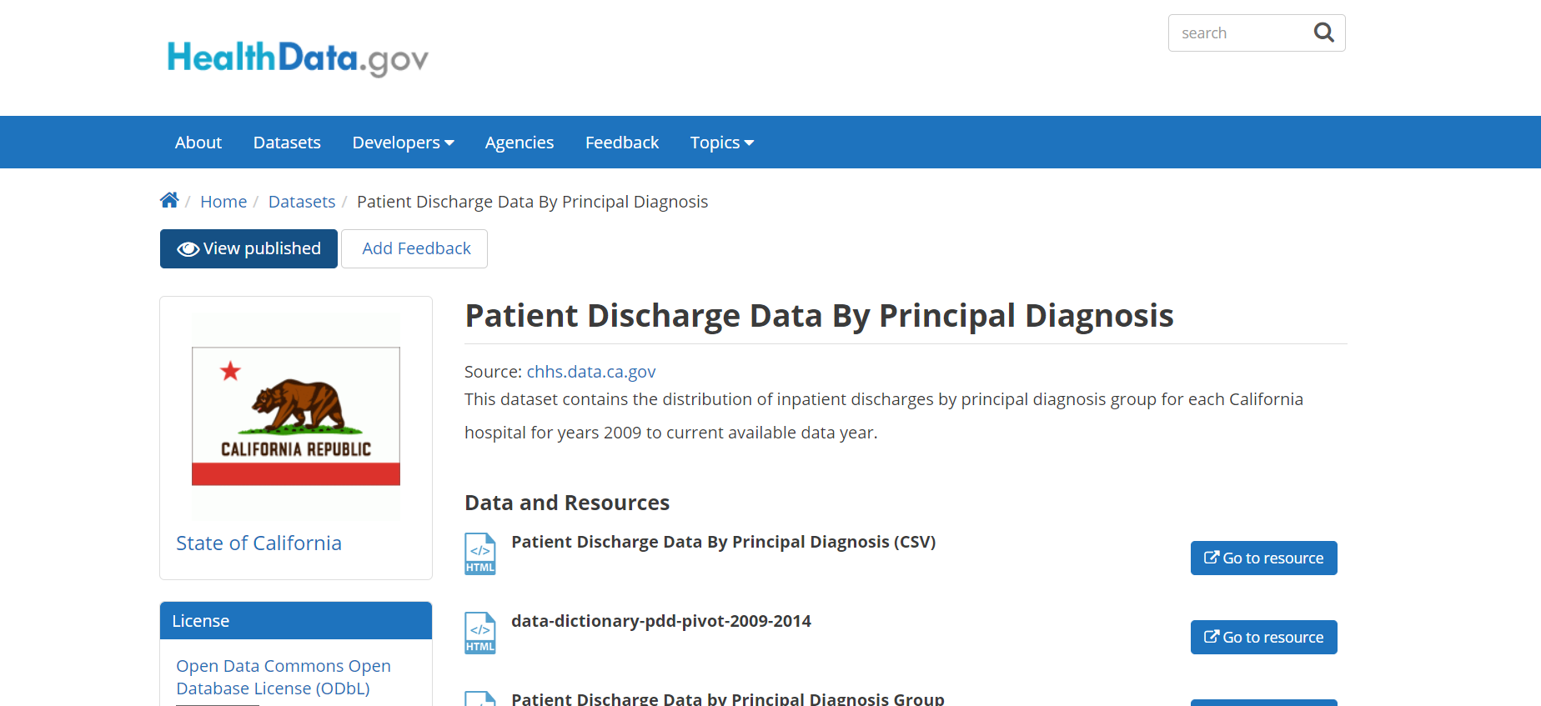

Slide 14
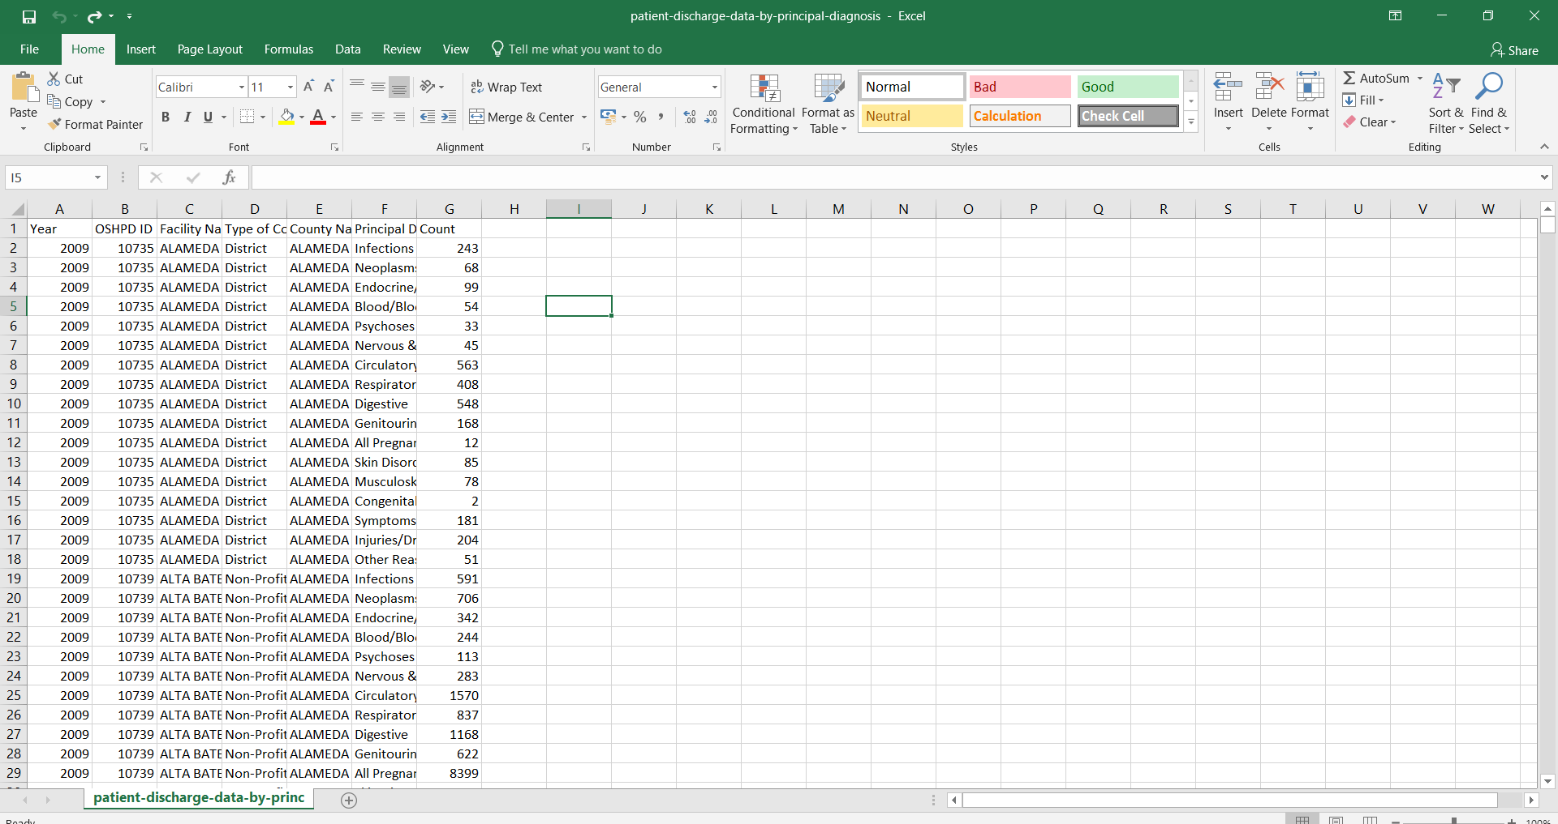

Slide 15
Another basic requirement was a platform.
Microsoft Azure Machine Learning Studio is a collaborative, drag-and-drop tool you can use to build, test, and deploy predictive analytics solutions on your data. Machine Learning Studio publishes models as web services that can easily be consumed by custom apps or BI tools such as Excel.
Machine Learning Studio is where data science, predictive analytics, cloud resources, and your data meet.

Slide 16
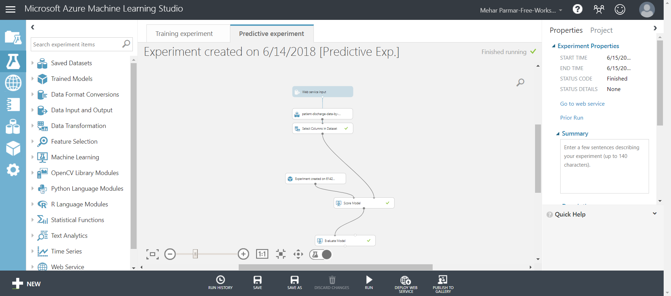

Slide 17
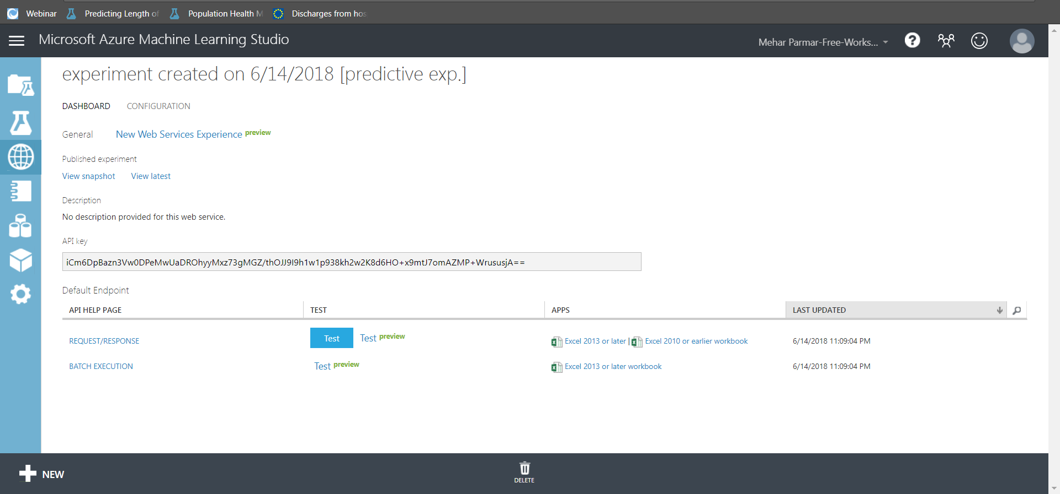

Slide 18
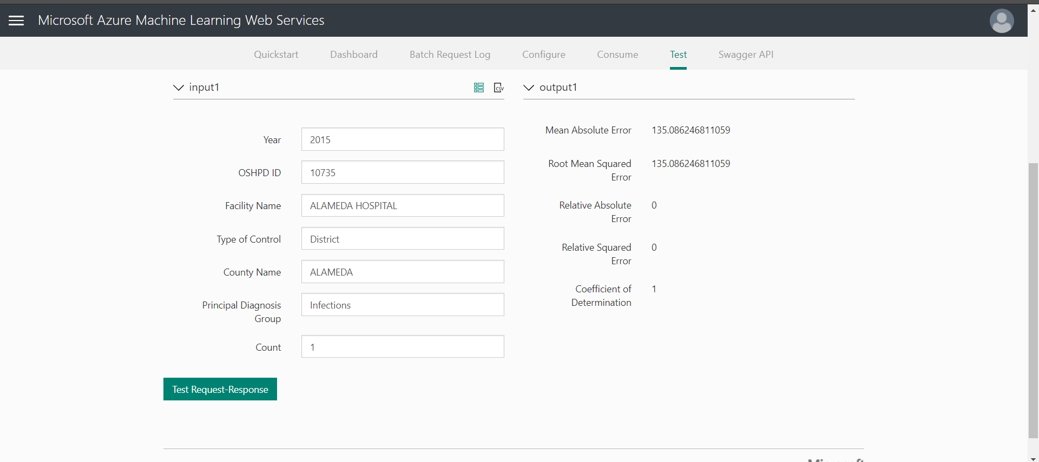
TEST VERIFICATION

Slide 19

LINK TO PUBLISHED EXPERIMENT
https://gallery.cortanaintelligence.com/Experiment/tech-knights

Slide 20
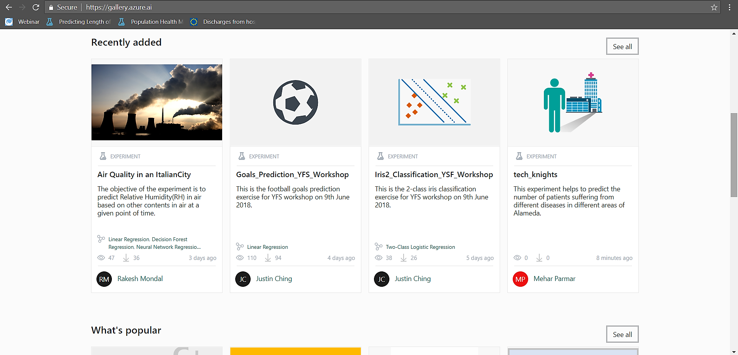

Slide 21
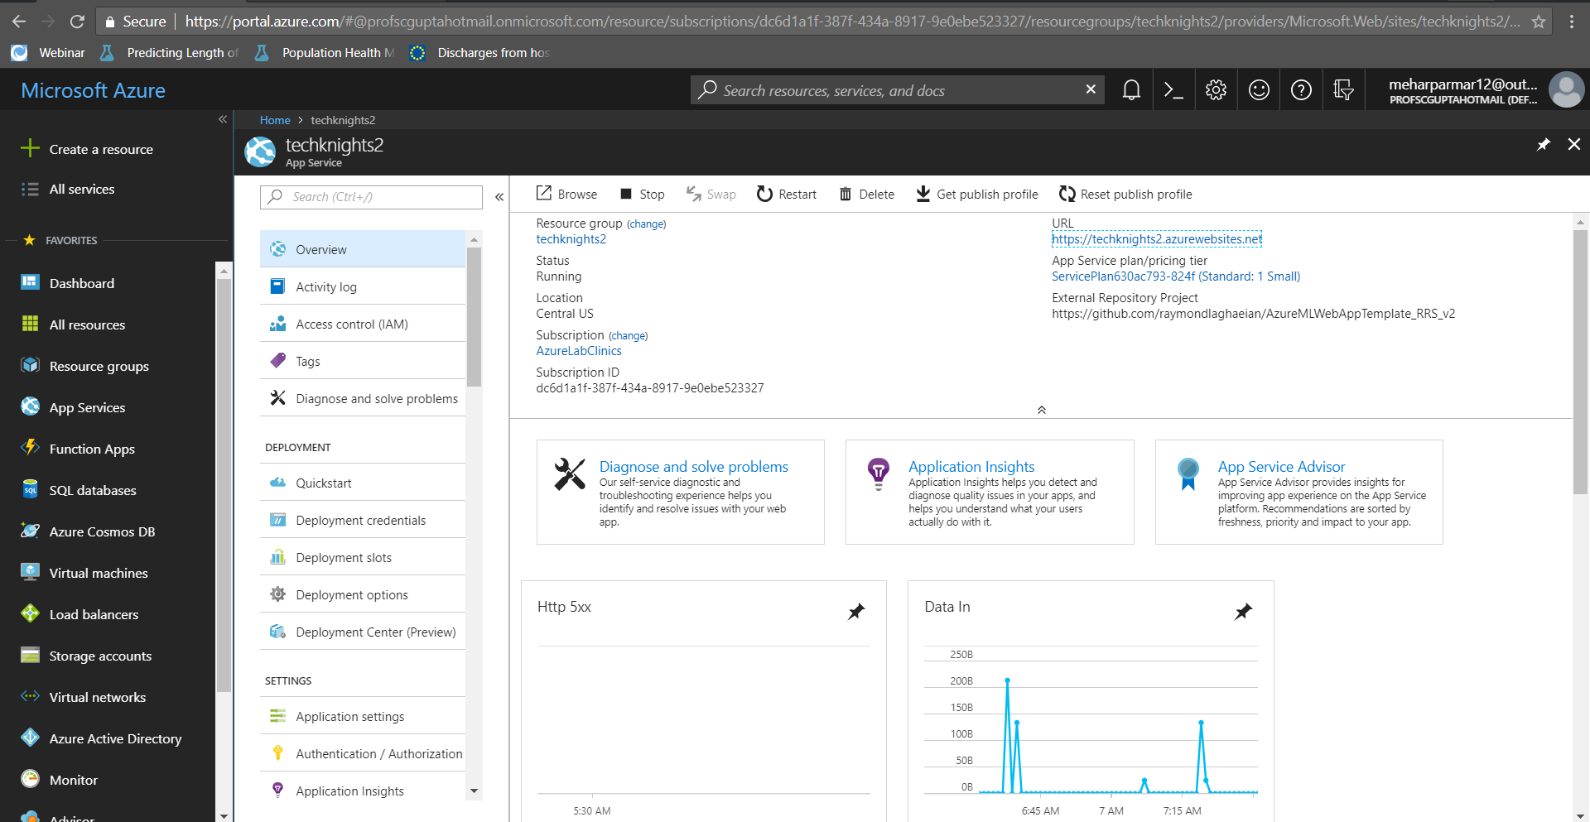
APP SERVICE CREATED IN Azure portal

Slide 22
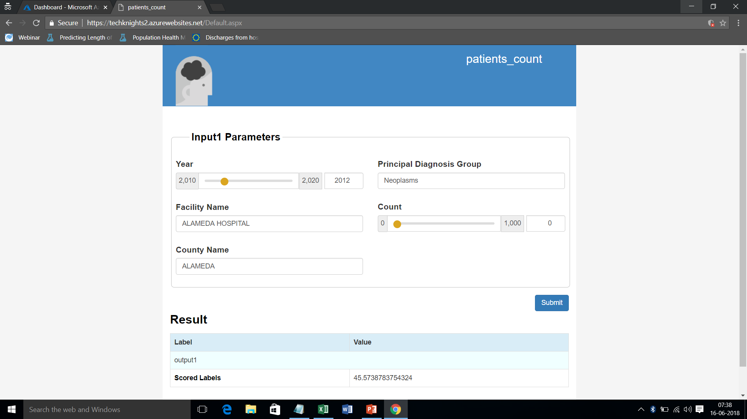
Patients_COUNT

Slide 23
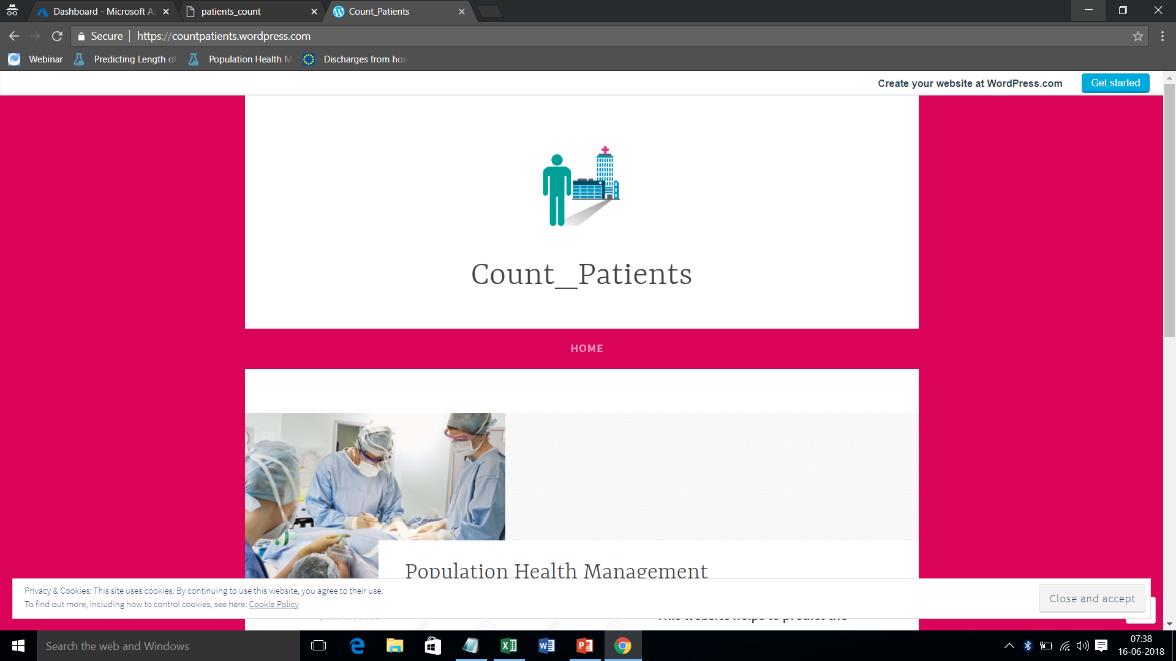
WEBSITE

Slide 24
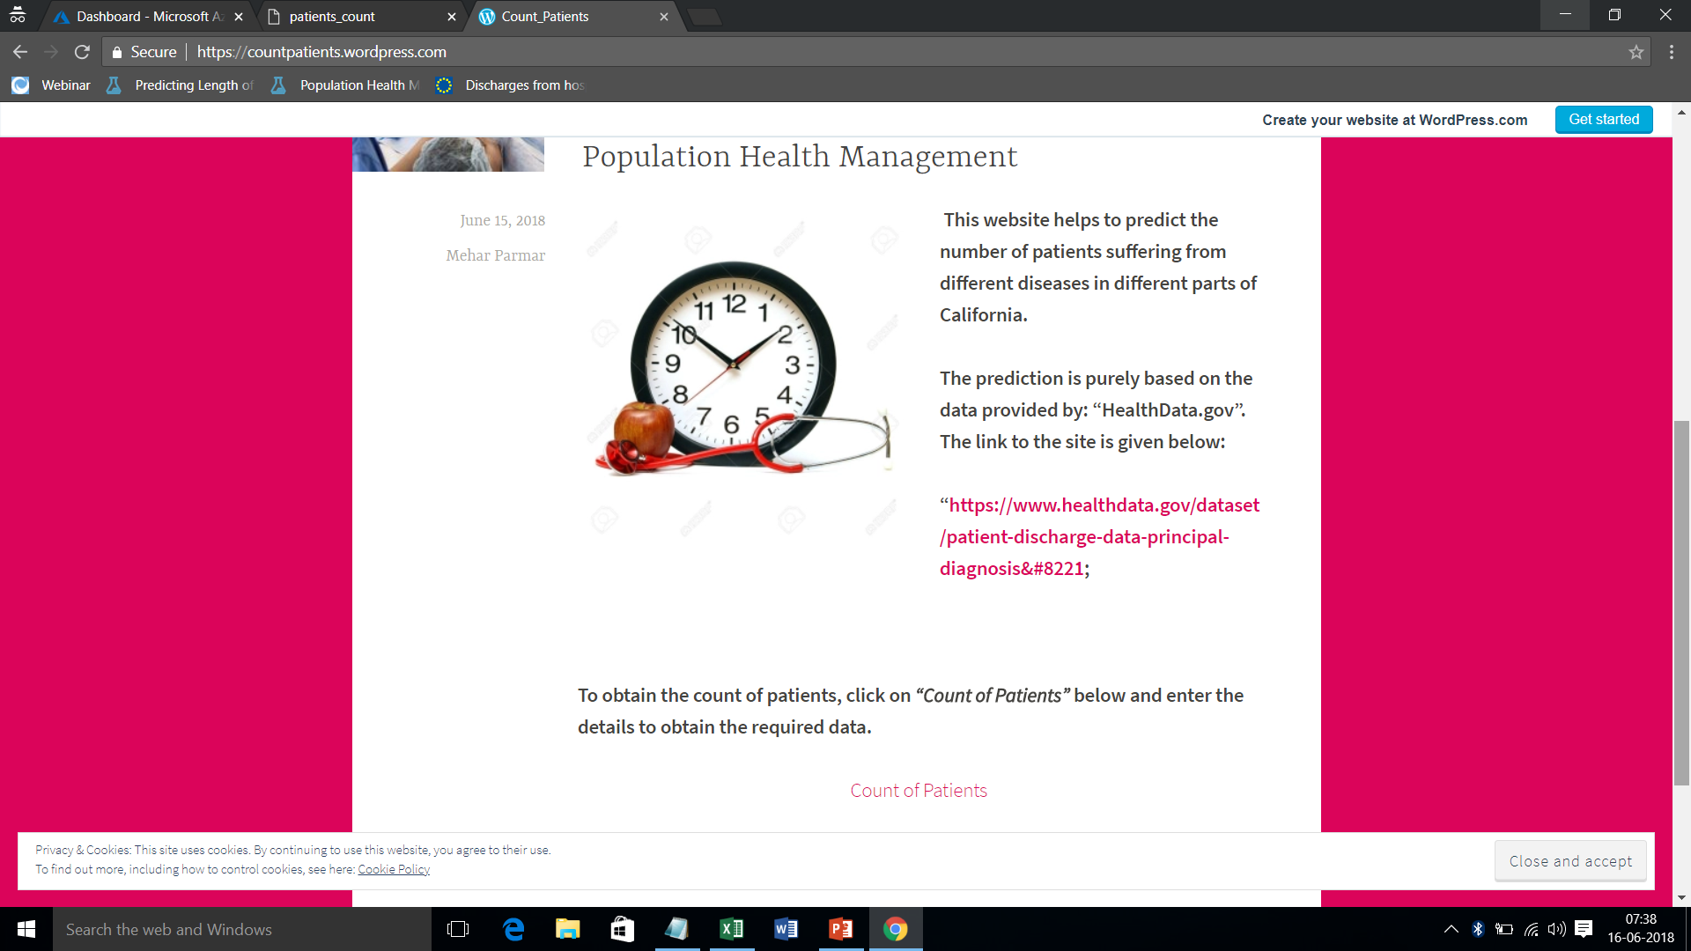

Slide 25


